Slide 1

Customer Shopping Trend Analysis
From Data to Dashboard: Leveraging Python, SQL, and Power BI for Actionable Insights

Slide 2
Project Overview & Objectives
Analyze Sales Drivers: Use 3,500 transactions to understand core sales performance and retention.
Segment Customers: Dissect purchase behaviors to identify high-value customer segments.
Evaluate Subscription Model: Assess the effectiveness of the current subscription program.
Provide Actionable Insights: Optimize marketing spend and product placement for growth.

Slide 3


Dataset at a Glance
Scope & Structure
Key Features
Rows: 3,500
Columns: 18
Missing Data: 37 (Review Rating)
Demographics (Age, Gender, Location)
Purchase Details (Item, Category, Amount)
Behavior (Discount, Frequency, Rating)

Slide 4





Data Preparation Pipeline (Python)
Load & Clean
Standardize
Engineer & Load
Imported data with pandas, checked `df.info()`, and imputed missing 'Review Rating' values using the category median.
Renamed columns to snake_case for readability. Checked for and removed the redundant 'promo_code_used' column.
Created 'age_group' from customer ages. Loaded the final cleaned Data Frame into a PostgreSQL database for SQL analysis.

Slide 5
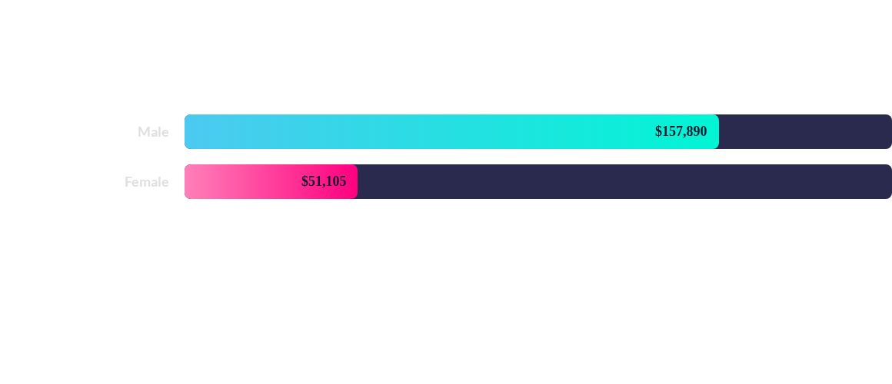
SQL Insight: Revenue by Gender
The analysis shows that Male customers generate significantly higher total revenue ($157,890) compared to Female customers ($51,105).

Slide 6
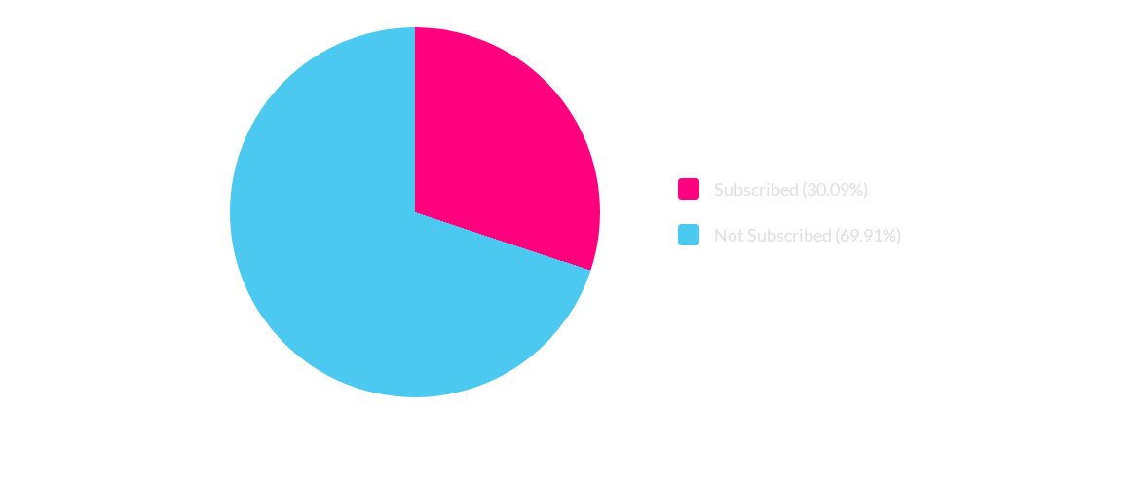
SQL Insight: Subscription Status Distribution
A significant majority of the customer base (69.91%) are non-subscribers, highlighting a major opportunity for conversion.

Slide 7
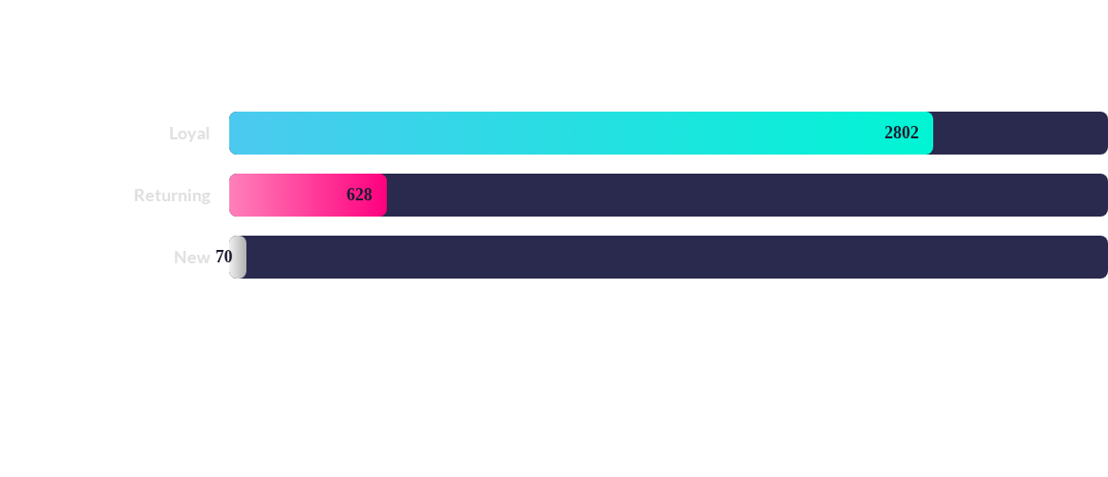
SQL Insight: Customer Segmentation by Purchase History
The customer base is overwhelmingly 'Loyal' (2802 customers), indicating strong retention. 'New' customer acquisition is a smaller segment (70 customers).

Slide 8
SQL Insight: Key Product Analysis
Analysis Type | Product | Value
Top Rated | 1. Gloves | 3.89 avg. rating
Top Rated | 2. Sandals | 3.85 avg. rating
Top Rated | 3. Hat | 3.84 avg. rating
Discount-Dependent | 1. Hat | 59.00% discount rate
Discount-Dependent | 2. Sneakers | 55.00% discount rate
Discount-Dependent | 3. Coat | 52.00% discount rate

Slide 9
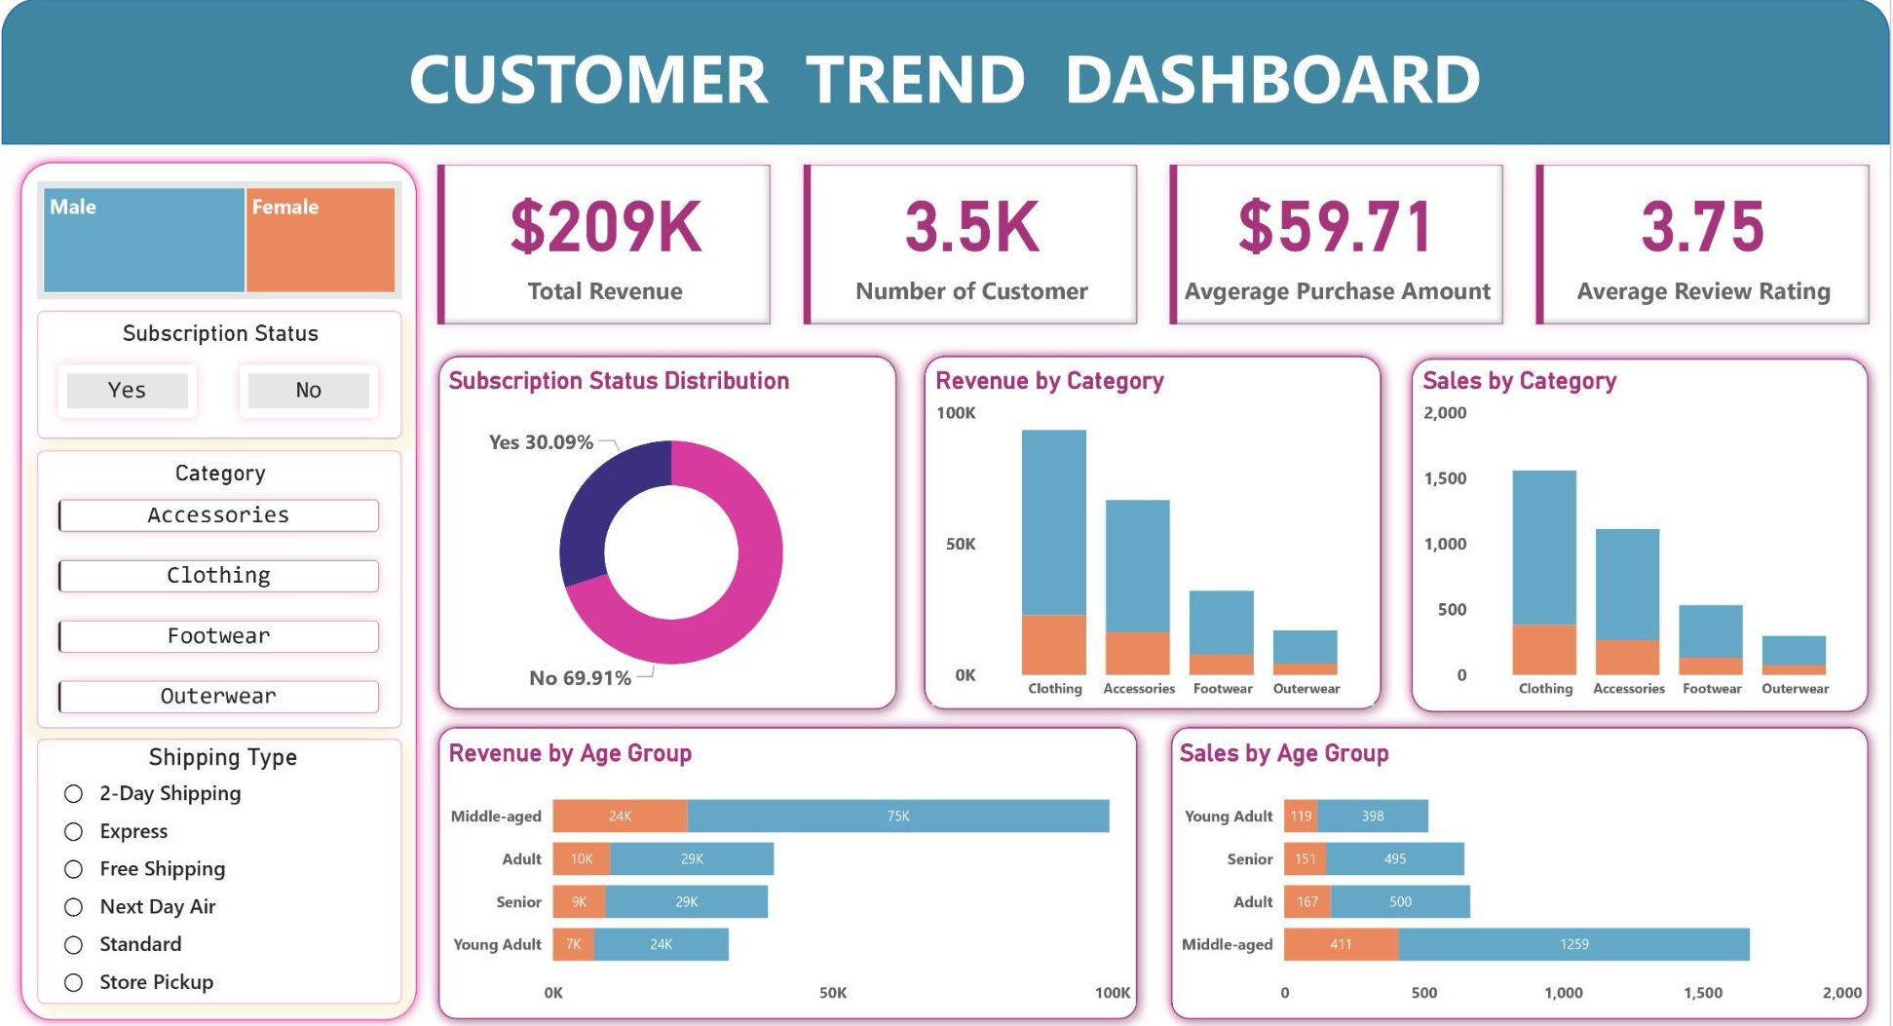
Visualizing the Insights: Power BI Dashboard

Slide 10


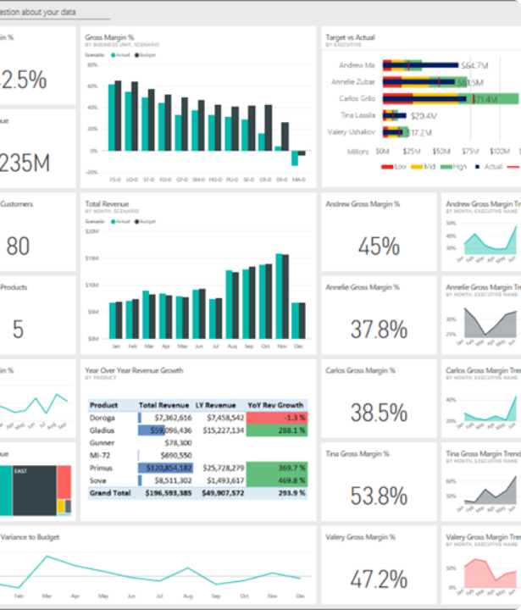
Visualizing the Insights: Power BI Dashboard
All SQL analyses and data points were consolidated into this interactive Power BI dashboard.
Key Performance Indicators
Total Revenue: $209K
Total Customers: 3.5K
Avg. Purchase Amount: $59.71
Avg. Review Rating: 3.75

Slide 11
Business Recommendations
Monetize Subscribers: Leverage higher AOV from subscribers by introducing tiered benefits and exclusive, higher-priced product lines.
Build Customer Loyalty: Design targeted campaigns to convert 'Returning' customers into the 'Loyal' segment, capitalizing on their high subscription correlation.
Review Discount Policy: Re-evaluate the discount strategy, especially for products like 'Hat', to balance sales volume with profit margin control.

Slide 12
Business Recommendations
Optimize Product Positioning: Prominently feature top-rated (Gloves, Sandals) and best-selling products in marketing campaigns and on the homepage.
Implement Targeted Marketing: Focus marketing efforts on the most valuable segments identified: high-revenue age groups (Middle-aged) and users who prefer Express shipping.

Slide 13
Thank you
By Sahabaz Khan

